Slide 1
Capital Markets Board of TURKEY
POST TRADE and CENTRAL COUNTERPARTY
March 2017

Slide 2
Takasbank at a Glance
Profile
Takasbank is the central clearing and settlement institution of Turkish capital markets providing post trade and CCP services as well as authorized as a sector specific investment bank facilitating settlement finality for its members/participants.
1988- A department within Borsa Istanbul
1992- Establishment of Borsa Istanbul Settlement and Custody Inc.
1996- Transformation to an investment bank
2013- Central Counterparty (CCP) in Securities Lending Market
2014- CCP in Derivatives Markets
2015- SSS in equities& debt instruments markets
2016- QCCP
Takasbank Subsidiaries
Shareholder Structure
0,024%
64,9%
0,15%
10,5%
4,1%
5%

Slide 3

Takasbank as a Financial
Market Infrastructure
SSS
CCP
Bank
Custody
Securities Settlement System
Investment Bank
Central Counterparty
Custody for funds
Capital Markets Board
Central Bank of the Republic of Turkey
Banking Regulation and Supervision Agency
Capital Markets Law
CBRT Law on Payment and SSS
Banking Law

Slide 4
Settlement Principles
Book Entry Settlement
Centralized Clearing and Settlement
T+0 Settlement for Debt Instruments
Multilateral Netting
Delivery versus Payment (Model 3 DvP)
T+1 for cash derivatives settlement
T+3 for physically settled stock options
Same day funds
Rolling Settlement
T+2 Settlement for Equities

Slide 5
Equity Market Post Trade Services
Borsa Istanbul Equity Market
Members
      Brokerage houses
Securities traded
      Stocks, warrants, ETFs traded in Borsa Istanbul Equity Market
Takasbank services
      Clearing/netting and settlement services
        Two netting processes are accomplished
      Netting on trade participants level
      Netting on account basis (to be transmitted to CRA in order for settlement to be finalized at the beneficial owner level)
      concludes the calculations of debit and credit on the same day (T).
Central Registry Agency, official custodian for equities
      Dematerialized stocks are safe-kept in the CRA system as book entry
      Transfer of securities between the customer accounts and settlement pool accounts take place in the CRA system.

Slide 6
Equities Market Cutoffs
Borsa Istanbul
First session; T 09:15-12:30
Opening session; T 09:15-09:35
Continuous Auction; T 09:35-12:30
Second Session; T 14:00-17:40
Opening session; T 14:00-14:15
Continuous Auction; T 14:15- 17:30
Closing Session; T 17:30 – 17:40
Takasbank
Security Settlement time T+2 8:00-16:45 (same-day default payment: 19:55)
Cash Settlement time T+2 8:30-16:45 (same-day default payment: 19:55)
Cut-off time for equity obligations T+2 16:45
Cut-off time for cash obligations T+2 16:45

Slide 7
Types of Member
General Clearing Member (GCM)
Direct Clearing Member(DCM)
Non-Clearing Member(NCM)

Slide 8
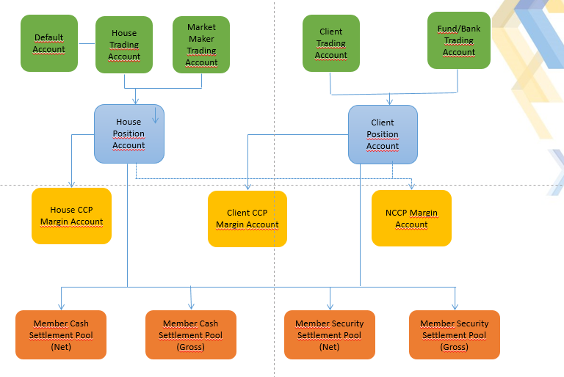
Account Structure

Slide 9
Trade Amendment
Poisition Transfer
(Give-up/Take-up)
Trade amendtments for as below issues will be done in Takasbank Clearing System.
  Client number
  Fund Code
  Account category (House/Client/Fund)
It will be possible to transfer the positions one member to another member.
There are 3 types of give up.
    During the Order entering
    After order entering
    Position Transfer
For occuring the give up, member who gets the transfer should approve the take up

Slide 10
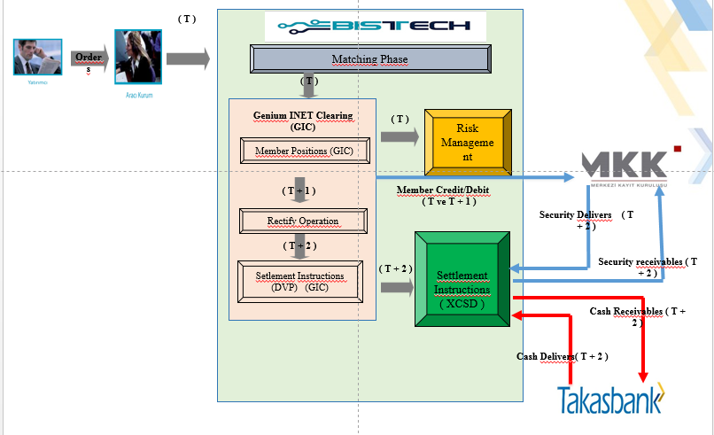


Cash Equity Settlement Flow

Slide 11
Multilateral Clearing-Settlement
Positions and Flow
All trades done at the exchange are settled T+2 with multilateral netting and risk management from the trade capture until the settlement is finalized (i.e. the delivery versus payment has been done).
Trades can be amended T+1 and the settlement instruction is created end of day T+1 and sent for settlement at T+2.
Settlement position accounts in Genium INET Clearing are on the level: House, Client Omnibus. The system also allow for defining Segregated client accounts if and when applicable. In the later case it is expected that a corresponding segregated pool account is used.
However all trades include information about the end investor. That information is not used as part of the settlement but is aggregated into a special file that is sent over to MKK for further internal processing. This file is created end of day T (preliminary) and at the end of day T+1 (final including amendments) for trades settled at T+2.
Settlement instructions are generated for participant-level settlement within the X-stream CSD settlement engine. The settlement engine interacts with depository and banking for achieving delivery versus payment settlement of settlement instructions. Settlement instructions may also be settled partially on a proportional basis, if there is a lack of assets and partial settlement is allowed. Settlement status is sent back to Genium INET Clearing for position update.

Slide 12
Cash Equity Critical Hours
Security obligation cut off time : 16:45
Cash obligation cut off time : 16:45
After 16:45 Overdue procedure applies
OFFSET HOURS
Fixed Income Market : 14:30
TAKASBANK Money Market : 15:45

Slide 13
Default Penalty
Base Value * Interest Rate* Day * Coefficient
----------------------------------------------------------
360
Base Value
Cash : Late fullfilment amount
Security : Quantity * Price
Fiyat : Weighted Average Price
Settlement date interest rate
Repo-Reverse Repo Market
Interbank Repo – Reverse Repo Market
CBRT Interbank Money Market
Takasbank Money Market
The highest rate of Borsa Istanbul Repo – Reverse Repo Market, Interbank Repo – Reverse Repo Market, CBRT Interbank Money Market and Takasbank Money Market are used in calculation of pre/default penalties.

Slide 14
Cash Equity Critical Hours
Penalty Coefficients
For the fullfilment between 16:46 and 17:30 in T+2 date, base interest rate * 1 (coefficient: 1)
For the fulfillment after 17:31 or following days, base interest rate * 3 (Coefficient: 3)
Penalty Exceptions
In case Both security and cash default occurs, the basis amount which is under 166 TRY is exempt from penalty payment.

Slide 15
DEBT SECURITIES MARKET POST TRADE SERVICES
Clearing Members
  Banks
  Brokerage Houses
  Central Bank The Republic of Turkey (CBRT)
  Market members are also clearing members.
Traded Securities
  Government Debt Securuties
    Government Debt Securuties
    Treasury Bills
    CBRT Liquidity Bills
    Revenue Sharing Certificates
    Bonds issued by Privatization Administration Office
    Sukuk
    Eurobonds
  Corporate Debt Securuties
    Private Debt Securuties
    Commercial Papers
    Banks Bills
    Asset Backed Securities
    Sukuk-Leasing Certificates
    Sub-Markets
    Outright Puchases and Sales Market
    Offering Market for Qualified Investors
    Repo – Reverse Repo Market
    Interbank Repo – Reverse Repo Market
    Repo Market for Specified Securities
    Equity Repo Market

Slide 16
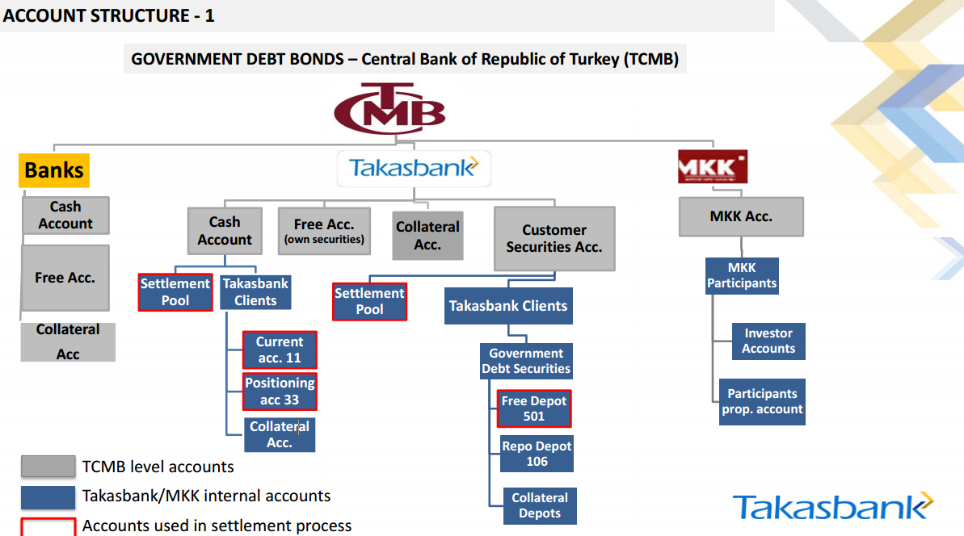



Slide 17
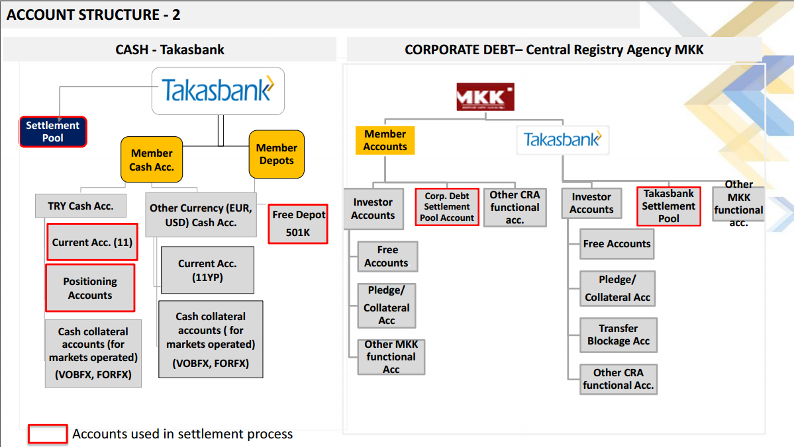



Slide 18
Custodian Services
  CUSTODY SERVICES OF DEBT SECURITIES MARKET
  Central Depository of Government Debt Securities is CBRT
  There are not Physical Government Debt Securities at Takasbank
  Securities safe kept in Takasbank are monitored in Takasbank account held with CBRT
  Details in member and depot basis are monitored in Takasbank system
  Custody of Government debt securities belonging to customers are in MKK
  CUSTODY SERVICES OF CORPORATE DEBT SECURITIES
  Central Depository of Corporate Debt Securities is MKK
  There are not Physical Corporate Debt Securities at Takasbank
  Customers’ Corporate Debt Securities are monitored in members’ accounts in member based by MKK.
  The balances of Investment funds, pension funds, trust company, and insurance company are monitored at Takasbank accounts held with MKK.

Slide 19
Debt Securities Clearing and Settlement
The settlement of the transactions in Borsa Istanbul Debt Securities Market is generally performed on the value date. (T+0).
Clearing and Settlement of Borsa Istanbul the Outright Purchases and Sales Market, Offering Market for Qualified Investors, Repo-Reverse Repo Market, Interbank Repo-Reverse Repo Market and Equity Repo Market are performed by Takasbank.
The settlement of Domestic Government Debt Securities with foreign currency denomination is performed on the T+1 day.

Slide 20
Trading and Critical Hours
Trading Hours ; 09:15 – 14:00
Allocation of securities subject to the reverse repo ; 15:00
Netting and credit/debit calculation ; 15:00 – 15:15
Fulfilling clearing and settlement obligations; 15:15 – 16:45
To implicate the future value – dates trades to the clearing on the value date of transactions.
Clearing and settlement of Domestic Government Debt Securities with foreign currency denomination are performed at T+1 day.

Slide 21
Clearing Principles
Netting
DvP
Dematerialized (on account) Clearing

Slide 22
Netting -1-
Trade contracts ,which are eligible for netting, are determined among all traded contracts.
Trades ,which are performed in Outright Purchases and Sales Market, Offering Market for Qualified Investors, Repo – Reverse Repo Market, Interbank Repo – Reverse Repo Market and Repo Market for Specified Securities are netted on security and cash based at Value date;
*Trades in Outright Purchases and Sales Market,Offering Market for Qualified Investors and Repo Market for Specified Securities;
*Securities debited for repo transactions in Repo - Reverse Repo Market and Interbank Repo – Reverse Repo Market ;
*Creditted securities on Repo Transaction (Maturity date of contracts, value date 2)
are netted on securities and cash basis at member level
Securities purchased with reverse repo are not included in netting. These securities are safekept in the «reverse repo blockage depot «of the member account who made reverse repo, until the maturity date of the transaction.
Reverse repo blockage are not used in Repo market for Specified Securities. In other words, members can use securities until the maturity date of repo transactions at Repo Market for Specified Securities.
Netting of Equity Repo Market Transactions are separately performed at customer based.

Slide 23
Netting -2-
Fund – member transfers subject to the credited/debitted on repo transactions, are performed automatically by Takasbank Clearing System.
Within the context of DVP principle, receivables are blocked as amount of market value of total debts.
-But this principle is not valid for CBRT. Firstly receivables of CBRT are sent, then CBRT fulfills its settlement obligations.
Blocking is considered beginning from most liquid one to the less liquid one
Release of blockage is considered beginning from the less liquid one to the most liquid one.
Cash
BLOCKING Security (Free Depots) RELEASING of BLOCKAGE
Security (Repo Blockage Depot)

Slide 24
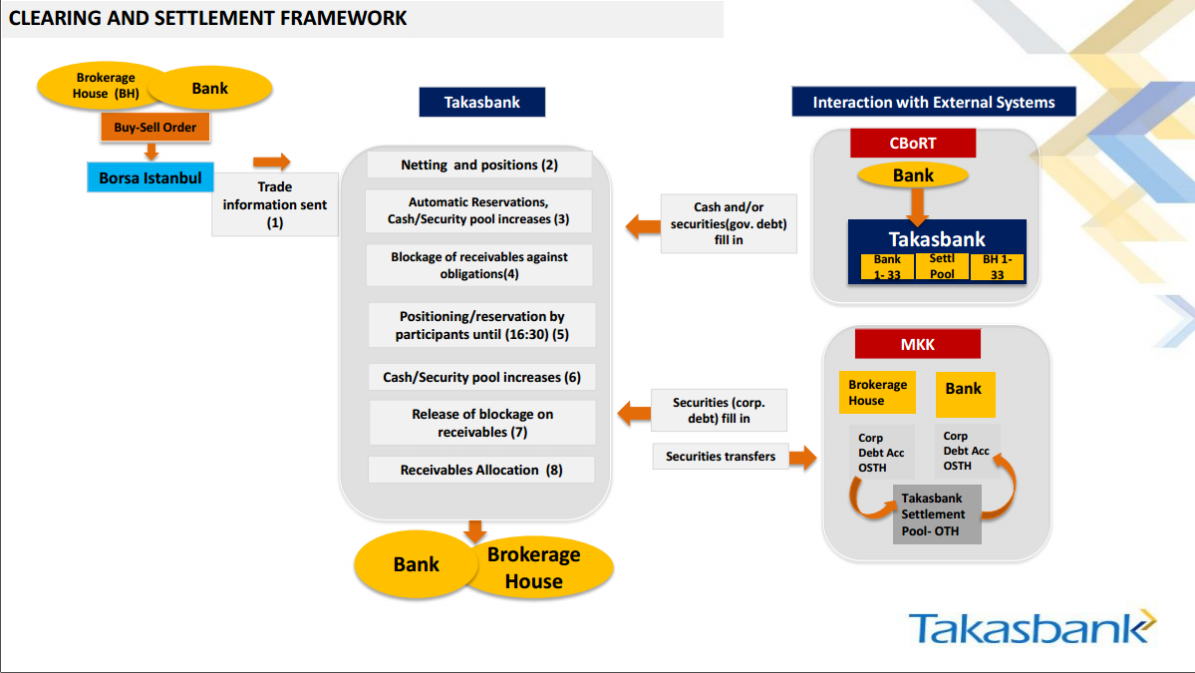

Slide 25
Security Clearing and Settlement of Debt Securities Market (FX)
Debtor members should have the securities at free accounts ;
  For Euro Denomination ; until 15:00 (Turkish local time)
  For Dollar denomination ; until 16:45 (Turkish local time)
As soon as reconcilement is received from correspondent banks about whether cash debtors fulfill their cash obligations to correspondent banks or not, receivables are transfered to creditors.

Slide 26
Default Procedures of Debt Securities Market
For the cash obligations;
  If the cash obligations are fulfilled via EFT, time of transfering of money to Takasbank (TIC) account at CBRT is considered for default procedure.
  If the cash obligations are fulfilled from the Takasbank account’s of member, time of cash transactions are considered for default procedure.
For the security obligations;
  Fullfilment time of debt securities is considered for default procedures.
The highest rate of Borsa Istanbul Repo – Reverse Repo Market, Interbank Repo – Reverse Repo Market, CBRT Interbank Money Market and Takasbank Money Market are used in calculation of pre/default penalties.
Pre-default/default penalties are paid within 1 business day from the accrual date.
Pre-default/default penalty is calculated by basing on the calendar days between the date of default and fulfillment of the obligation.

Slide 27
Default Procedures of Debt Securities Market
All time Intervals, coefficient and lower,upper limit of default fees are listed in the chart given below;
These datas are updated every year according to Borsa Istanbul announcement
TYPE OF OBLIGATION | TIME INTERVAL | COEFFICIENT
CASH/SECURITY | 16:46-17:00 15:01-17:00 (Euro denomination) | 0,25
 | After 17:00 with same day value 0 | 0,50
 | After value date 3 | 3,00 (for the first default in the quarterly period) for each additional default the coefficient will be increased by 1 point.
Notification of Security Subject to Repo Transaction) | After 15:00 | 0,05
Additional Collateral for Loss in Value of Repo | 14:01-17:00 | 0,25
 | After 17:00 with same day value | 0,50
 | After value date | 3,00 (for the first default in the quarterly period) for each additional default the coefficient will be increased by 1 point.

Slide 28
Default Procedures of Debt Securities Market
If members can not fulfill their obligations at the T+1
By Borsa Istanbul;
Debt = security ; Blockage = Cash buy security
Debt = security ; Blockage = Security buy/sell security
Debt = cash ; Blockage = Security sell security
If the blocked receivables does not meet the liability, the member is asked to complete the difference; else collaterals which are kept at Borsa Istanbul are liquidated.
And, finally, the obligations are closed.
A payment for compensation payment is made by Takasbank to the members in creditor position with respect to cash or securities for the non-delivery or non-payment on value date equaling to the amount calculated by basing on two-fold of the higher of the overnight weighted average interest rates occurred in the Borsa Istanbul.

Slide 29
Redemption and Coupon Payment
of Government Debt Securities
Balance amount equal to balance of Takasbank account at CBRT, is transfered to Takasbank by Undersecretariat of Treasury
Undersecretariat of Treasury
TAKAS ISTANBUL
Redemption and Coupon Payment Process is run and allocation of payment is performed to related accounts.
Redemption and coupon payment balance is transfered to the redemption pool
Member cash account (+)

Slide 30
Redemption and Coupon Payment
of Corporate Debt Securities
Redemption and Coupon Payment amount are transfered to «MKK redemption and coupon payment Accounts» at Takasbank
Issuer
TAKAS ISTANBUL
MKK Redemption and Coupon Payment Account at Takasbank
Takasbank Redemption and Coupon Payment Account
.
Redemption and Coupon Payment Process is run and allocation of payment is performed to related accounts.
Member cash account (+)

Slide 31
FUTURES and OPTIONS MARKET POST TRADE
Borsa Istanbul Derivatives Markets Clearing & Settlement-I
Banks and brokerage houses (direct clearing members)
NCM, DCM and GCM structure
Securities traded
Futures on Single Stocks, BIST30 Index , Currencies (EURTRY, USDTRY, EURUSD), Gold (XAUTRY, XAUUSD), Electricity, Wheat, Cotton, Metal, ETF, O/N Repo Rate
Options (Single Stocks, BIST30 Index), USDTRY
Takasbank services
CCP for Borsa Istanbul Futures and Options Market since March 3, 2014
Determining clearing member acceptance criteria and VaR based risk limits
Determining position limits
Determining the risk parameters, collateral types, compositions and haircuts
Collateral valuation
3-layer risk management: pre-, at- and post-trade risk management
Announcing margin calls
Guarantee fund management
Cash management
Default management
Members
Takasbank CCP model
Inline with EMIR and ESMA regulations
Segregated collateral accounts (house and client)
Portability of collateral and positions
End-client (account) based daily mark to market

Slide 32
Borsa Istanbul Derivatives Markets Clearing & Settlement-II
Main Principles
CCP with Open Offer
Contracts are cash settled except for physically settled stock futures,options and ELUS futures.
T for cash settlement, T+2 for physically settled stock futures and options, T+5 for ELUS futures
Margin calls are paid in cash (TRY) or by closing out the positions
Clearing system and collateral management system are end-client (account) basis
Types of accounts: Portfolio, Market Maker, Customer
Daily losses and profits are reflected to the cash collateral at the end of the same trading day
Cash collateral is subject to cash management and net interest income is pledged to the accounts
Portfolio based margining

Slide 33
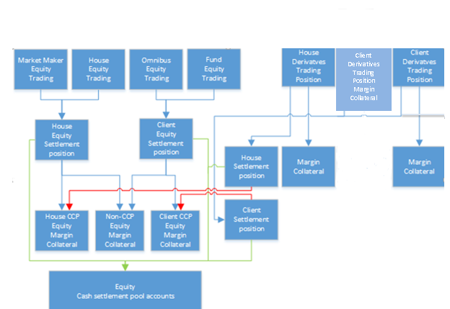
Account Structure
NCM
Equity Market
DCM, GCM
Futures and Options Market
DCM, GCM
Client
Derivatives Trading
Margin
Collateral
Position

Slide 34
Account Types
Trading Accounts: Only trades can be executed. Trading Accounts can’t hold position and collateral, they need to be propagated to a clearing account.
Position & Margin & Collateral Accounts: Trading accounts will be propagated to PMC accounts.
Trade & Position & Margin & Collateral Accounts: For TPMC Accounts, account propagation is not needed. Account type can also be market maker or omnibus
New templates with additional account details can be defined if requested by members.

Slide 35
Collateral Deposit / Withdraw Transactions
Collateral deposit- withdraw transactions is executed;
  Via member screens (Bistech Clearing Workstation) and
  Takasbank screens on behalf on members (CO-Clearing Office)
It is also be possible to deposit- withdraw collateral via file upload.
Simulate Margin: Members are able to calculate pre-trade margin requirements via BISTECH CW.

Slide 36
Rectify Trade / Cancel Deal
  Rectify trade is executed by member users on BISTECH Clearing Workstations
    Only for account number amendments
  Deal cancel is executed by Exchange officials
    on condition of the confirmation of counterparties for the deals executed same-day

Slide 37
Give-up/ Take-up
In BISTECH, position transfer to another member is performed in 2 different ways.
    Account Propagation= Automatic Give-up (Current) {DCM-DCM, NCM-GCM, DCM-GCM}
    NCM/trading account is able to monitor its own trades but positions, margining and collaterals will take place automatically in GCM which NCM agreed on (account propagation).
    Post-Trade Give-up
In order to perform give-up, take-up member shall confirm transaction.
It is possible to perform give-up between DCM and GCM.

Slide 38
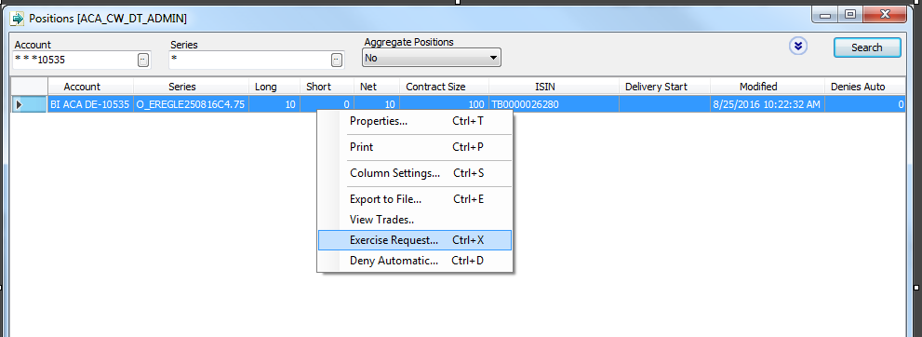
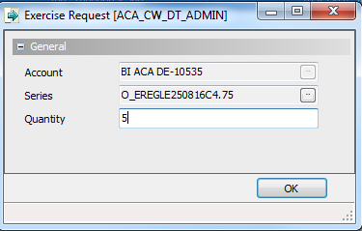
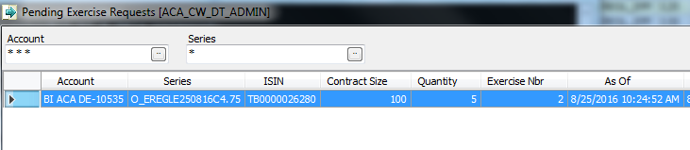
Option Exercise
Exercise requests are entered for the positions which will be exercised
Exercise requests are monitored intraday from Pending Exercise Request menu
For physical and cash settled option contracts, positions which are in profit at the expiration date are exercised automatically without the need of any exercise notice by Members. In case of exercise is not requested, “deny exercise” request will be sent via CW member screens.

Slide 39
Account Transfer (Portability)
Account transfer with position and collateral can be executed by members using BISTECH CW and position & collateral transfers are also need to be confirmed by receiving member. After receiving member’s confirmation, Takasbank executes the transfer.
- It is possible to transfer all types of cash and security.
Investor id check is performed/possible during transfer.
This function also can be used in case of a defaulting member transfer to ‘back-up’ member

Slide 40
Margin Call Penalty Process
T+1 15:00
For the accounts which has been defaulted by not paying its settlement obligations on T+1 day until 15:00, penalty fee is applied.
Penalty fee procedure will be applied.
Physical Delivery Cut-off Time
Equity T+2 -16:30
Wheat ELUS T+5 -17:00

Slide 41

CCP SERVICES
(available for Takasbank Securities Lending Market,
Borsa Istanbul Futures and Options Market and
Borsa Istanbul Money Market)
    Regulatory Framework
    Turkey Capital Market Law Nr. 6362
    General Regulation on the Establishment and the Operating Principles of Central Clearing Institutions
    Istanbul Settlement and Custody Bank Inc. Central Counterparty Regulation (Takasbank CCP Regulation)
      Market Directives (approved by CMB) and Market Procedures
    International Principles and Regulations
    CPMI-IOSCO PFMI
    EMIR (648/2012)
      EMIR Supplementary (152/2013) for capital requirements and (153/2013) for technical standards for CCPs
Reference
«Art 5/10 In any matters not expressly regulated by this Regulation, the capital market legislation and the other relevant legislation, Takasbank takes into consideration the international principles and regulations related to the CCP practice…»

Slide 42
Takasbank CCP Model
Default Management
Creating Dafault Waterfall
CCP Membership & Membership criterias
Collateral of the defaulted member and its defaulted customers
Collateral of the defaulted member and its defaulted customers
Default fund contribution of the defaulted member
Takasbank’s dedicated capital for covered risks (skin in the game)
Default fund contributions of other members (capped)
Additional default fund contributions of other members
Remaining capital of Takasbank (up to the regulatory capital)
Compensations to be made from insurance policies, if any

Slide 43
Takasbank CCP Model
Takasbank Capital
Risk Controls
Legal Basis
Member admission requirements
Segregation and Portability
Default Management
Margins and Collateral
Default Fund

Slide 44
Takasbank CCP Model
Types
Criteria
CCP MEMBERSHIP & LIMIT SETTINGS
Direct Clearing Member
Financial Strength (Takasbank Credit Rating System)
General Clearing Member
Minimum Capital Requirements
Non-clearing member

Slide 45
Takasbank CCP Model
    Margining Rules
    Initial margin
      Minimum %99 confidence level (%99.5 in VIOP and TSLM)
      Minimum 2 days liquidation period
      One-year look-back period
    Variation margin
    Portfolio margining
      Delta Hedge is used for VIOP

Slide 46
Takasbank CCP Model
    Eligible Collaterals & Evaluation Rules
Cash (TRL and FX)
Government Debt Securities
Investment fund units
Bank guarantees*
Stocks
Gold
    Haircut Calculation
      Minimum 99% confidence level (currently 99.9%)
      Minimum 2 days liquidation period
    Daily valuation of collaterals
    Theoretical price calculations
    Composition limits
    Minimum cash requirement (DM 50%, TSLM 60%)

Slide 47
Takasbank CCP Model
    Default Fund
    Will be maintained for each market
    For potential risks above the margin level (up to %99.9 confidence level)
    Size of the Default fund > Max(Largest Exposure, Second Largest Exposure + Third Largest Exposure)
    Members deposit
      Fixed contribution
      Variable contribution (proportional to the risks)
    Replenishment of default fund by the non-defaulting members
      Limited (12 times/year – VIOP, 4 times/year – TSLM)

Slide 48
Takasbank CCP Model
    Segregation
    Collaterals of CCP markets should be monitored separately from the assets of Takasbank – Capital Market Law Art. 78/7, CCP Regulation Art. 20/1
    «Customer positions and collateral should be segregated from the members’ own positions and collateral»
      Omnibus vs. Individual
      Individual segregation obligation for certain markets (Eg. Derivatives)
      The collaterals posted for the omnibus accounts shall be provided from the collaterals which belong to the member itself or on which member holds power of disposition

Slide 49
Takasbank CCP Model
    Portability
    Pre-default:
      Porting of collateral and positions is possible with the instruction of both transfering and transferee clearing members if Takasbank approves
    Post-default:
      Porting of collateral and positions is possible for individually segregated accounts if a back up member is determined before default or a back up member is found after default

Slide 50
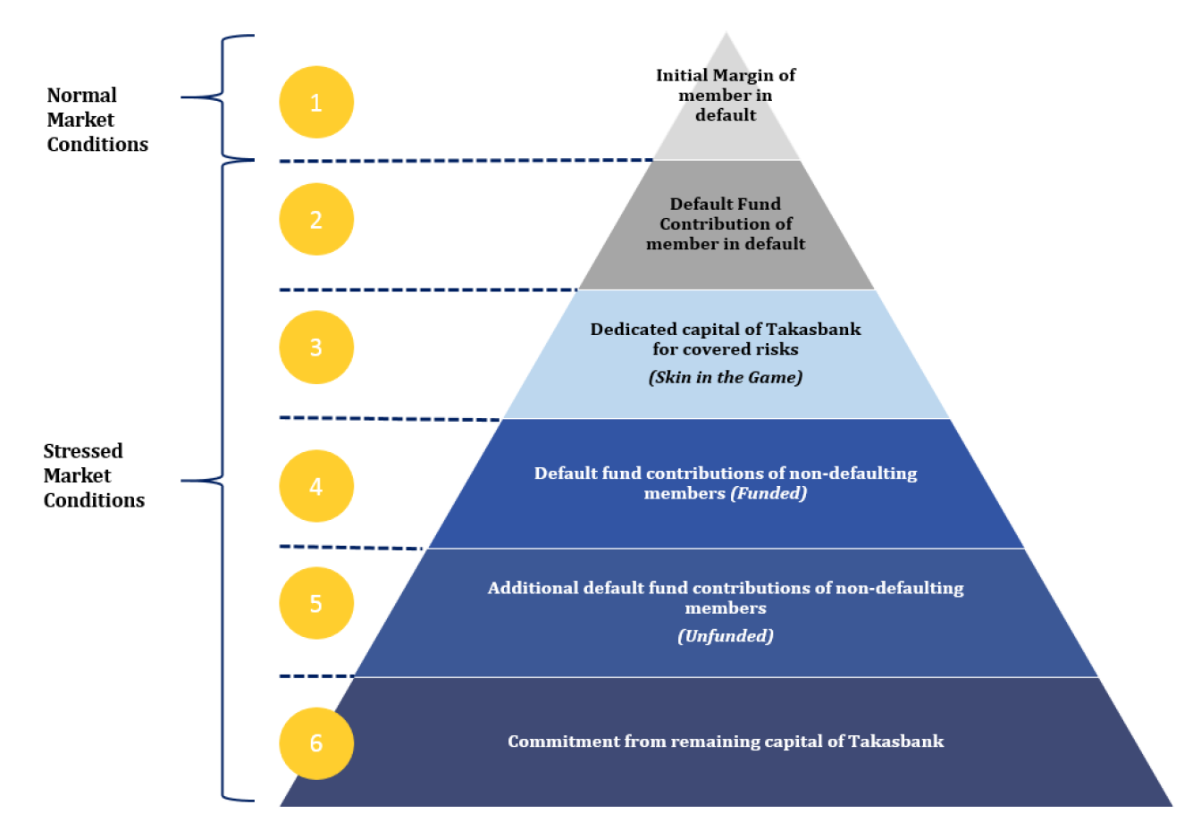
Takasbank CCP Model
    Default Management (Waterfall)

Slide 51
Takasbank CCP Model
    Default Management
    Risk Controls
    Closing out positions
    Porting customer positions and collateral
    Auctions for the positions of the defaulted member
    Variation margin haircutting under extraordinary circumstances
    Stress tests (stress tests, reverse stress tests, sensitivity analysis)
    Back tests
    Liquidity risk controls
    Credit and concentration risk controls

Slide 52
Takasbank CCP Model
    Takasbank’s Dedicated &Committed Capital
A
Minimum capital requirement under banking regulation for credit , market and operational risks (Basel 2 Pillar One)
B
Internal capital allocation for business risks and restructuring costs (75% of the previous year’s operational expenses related to CCP services)
C
Dedicated capital of Takasbank
for CCP services (for covered risks):
(25% of A+B)
D
Commitment made from the remaining capital of Takasbank: (Regulatory Capital -A-B-C- Other Internal Capital Allocations under Basel 2 Pillar Two)

